Slide 1

소프트웨어 공학개론 final presentation
Team 8
박건우
서의태
윤재한
정찬
김동희

Slide 2
Overview
Contributors
System Organization
Front-End UI
Back-End
Need Improve

Slide 3
Contributors

Slide 4
Front End
김동희
박건우
정찬

Slide 5
Back End
서의태
윤재한

Slide 6
System Organization

Slide 7
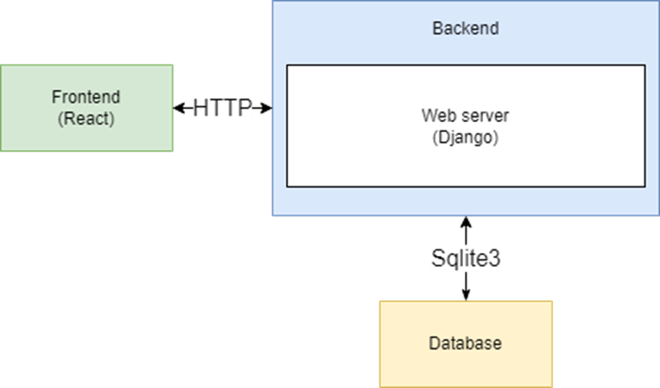
Overall Diagram

Slide 8
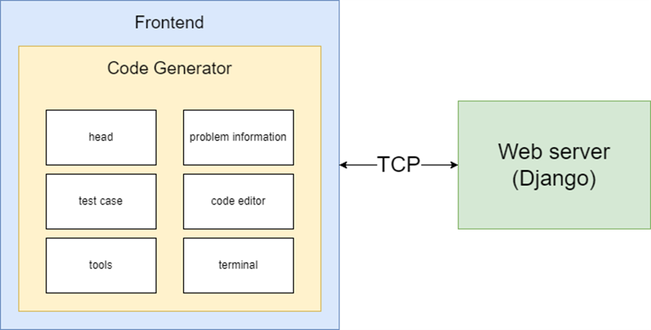
Front-End Diagram

Slide 9
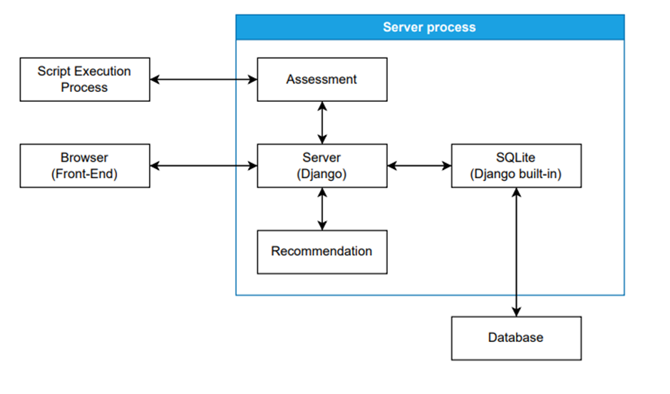
Back-End Diagram

Slide 10
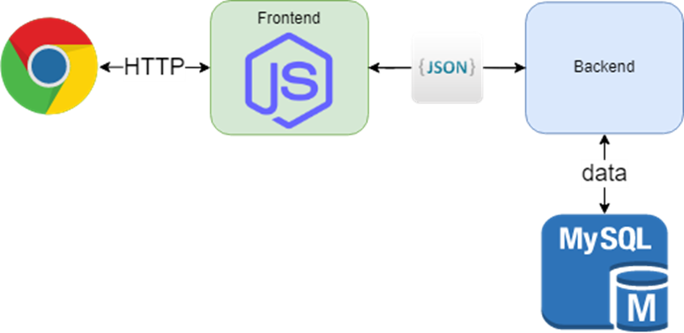
Overall Protocol Diagram
We use Google Chrome and HTTP for our website
Front and Back are connected through JSON
Backend uses MySQL to save and load data

Slide 11
Front-End UI

Slide 12
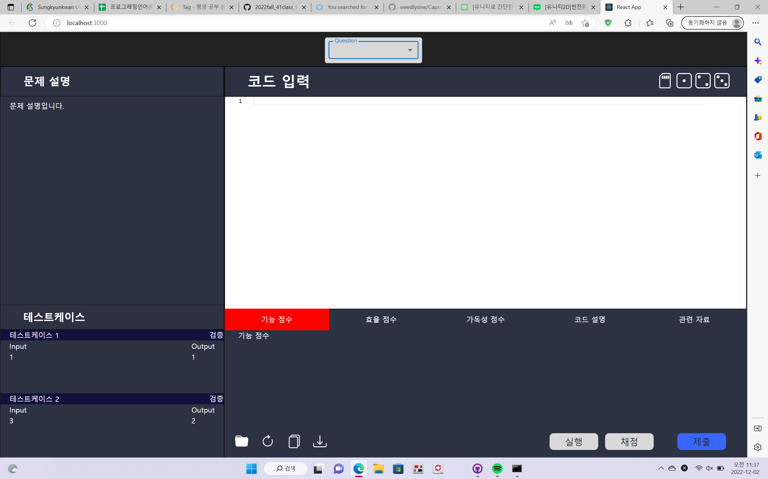
Basic Website
This is overall front end
You can save code
You can return to first state
You can download your code
You can execute your code
You can submit your code
You can score your code
You can copy your code

Slide 13
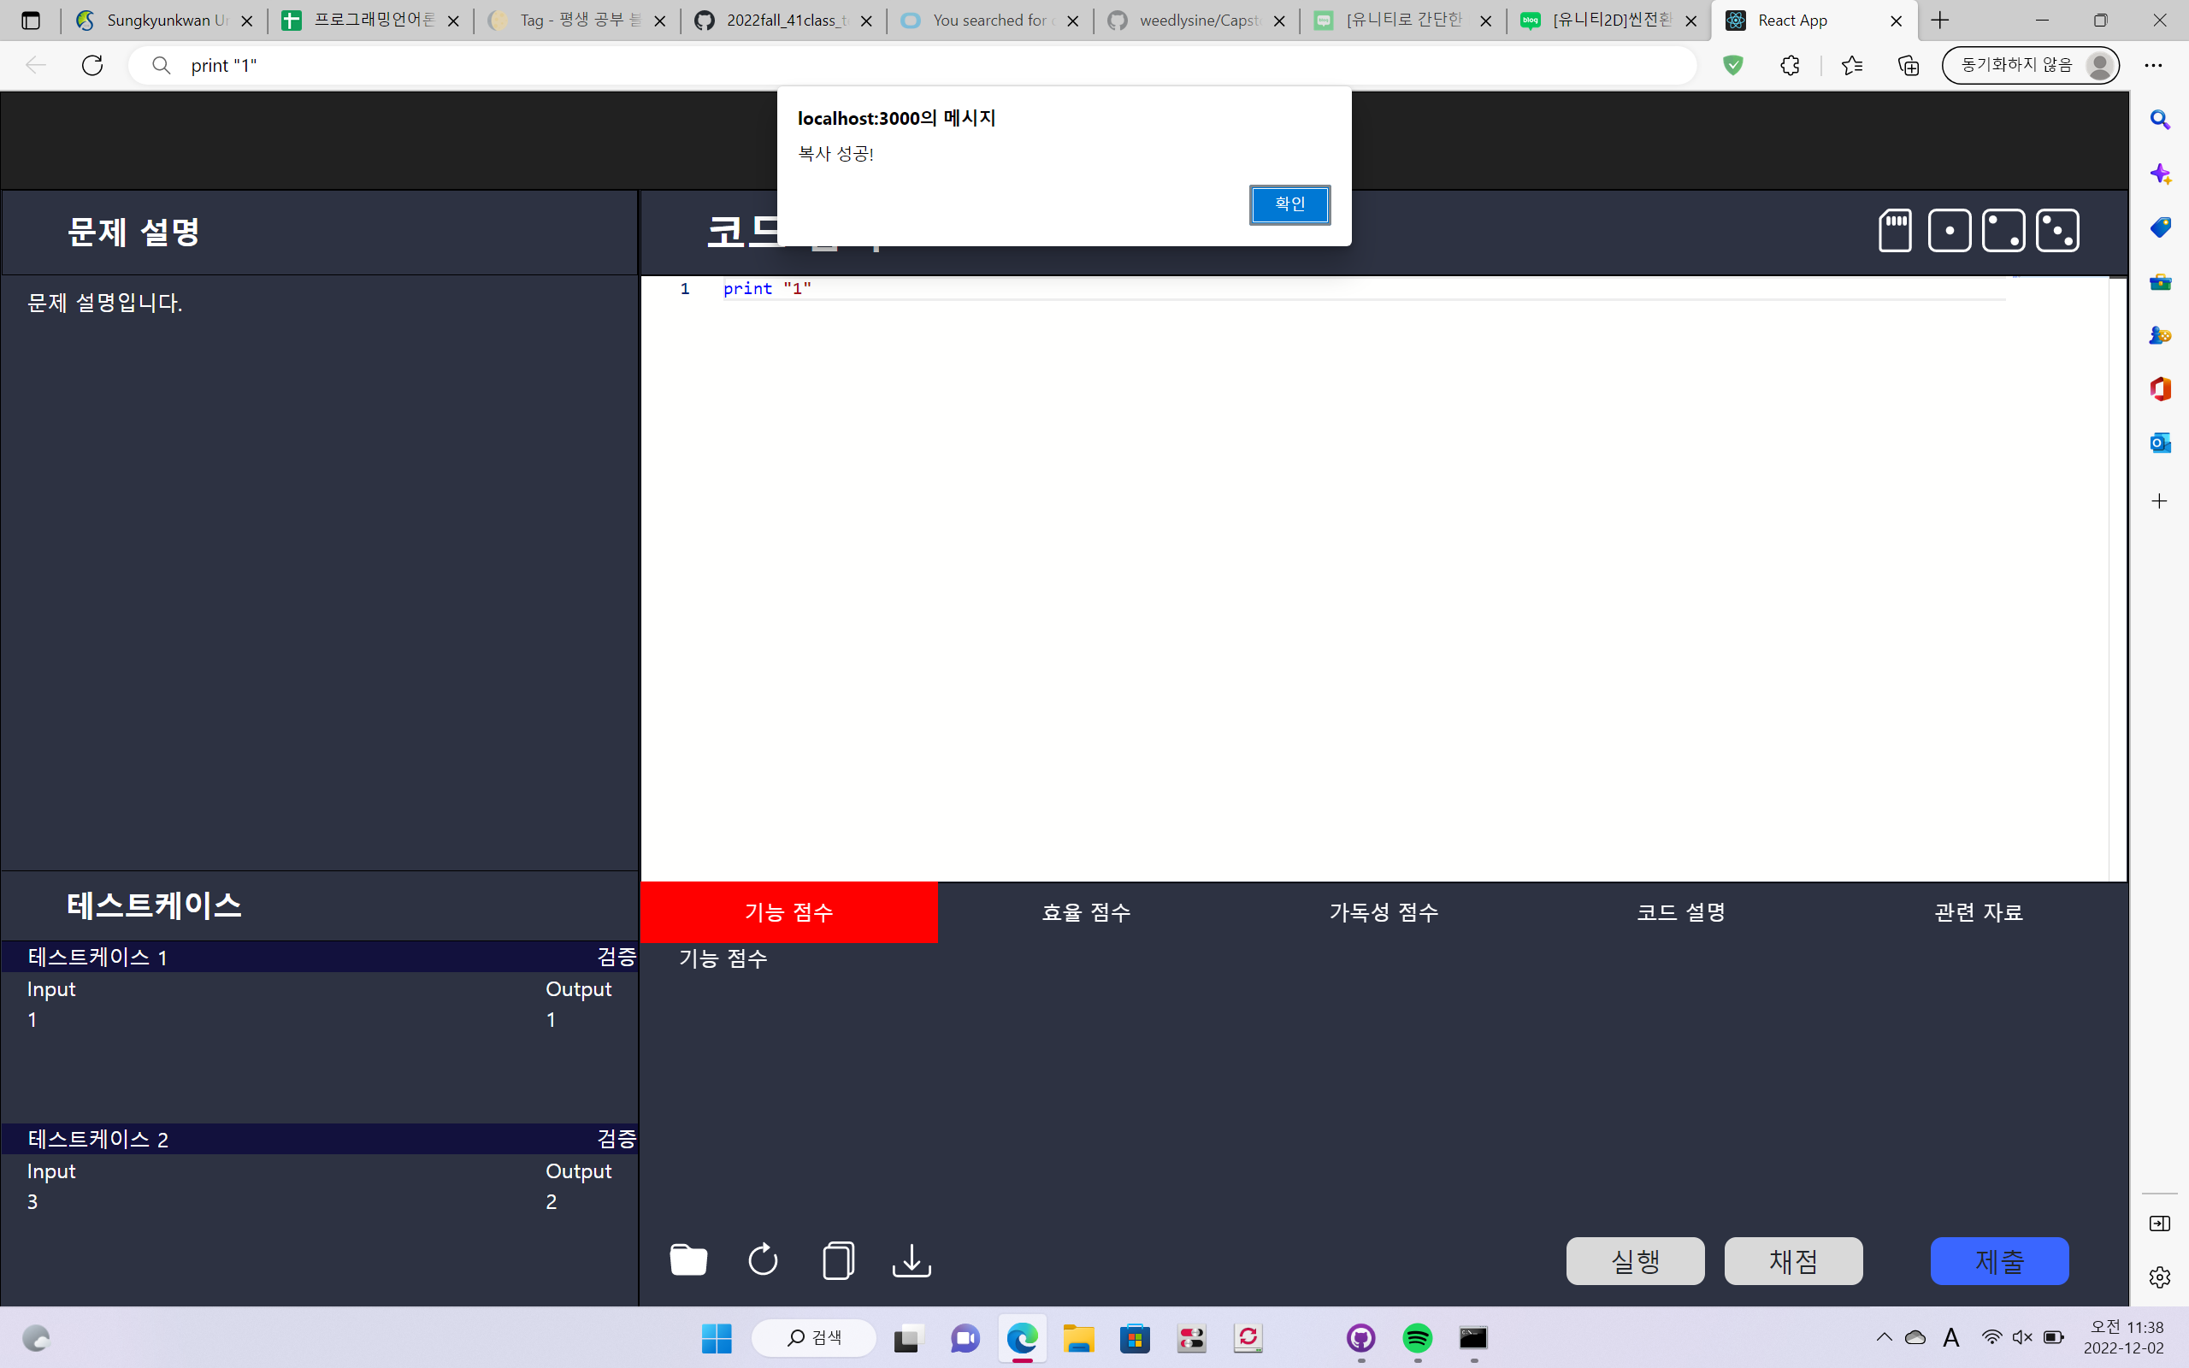

Copy Button

Slide 14
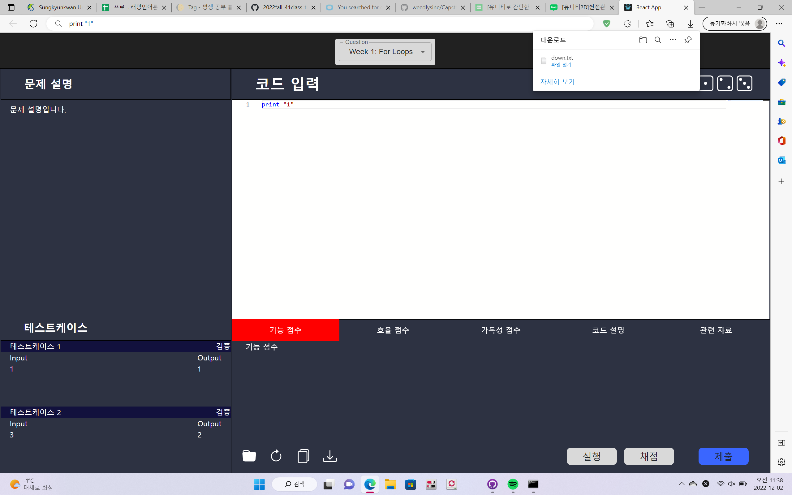
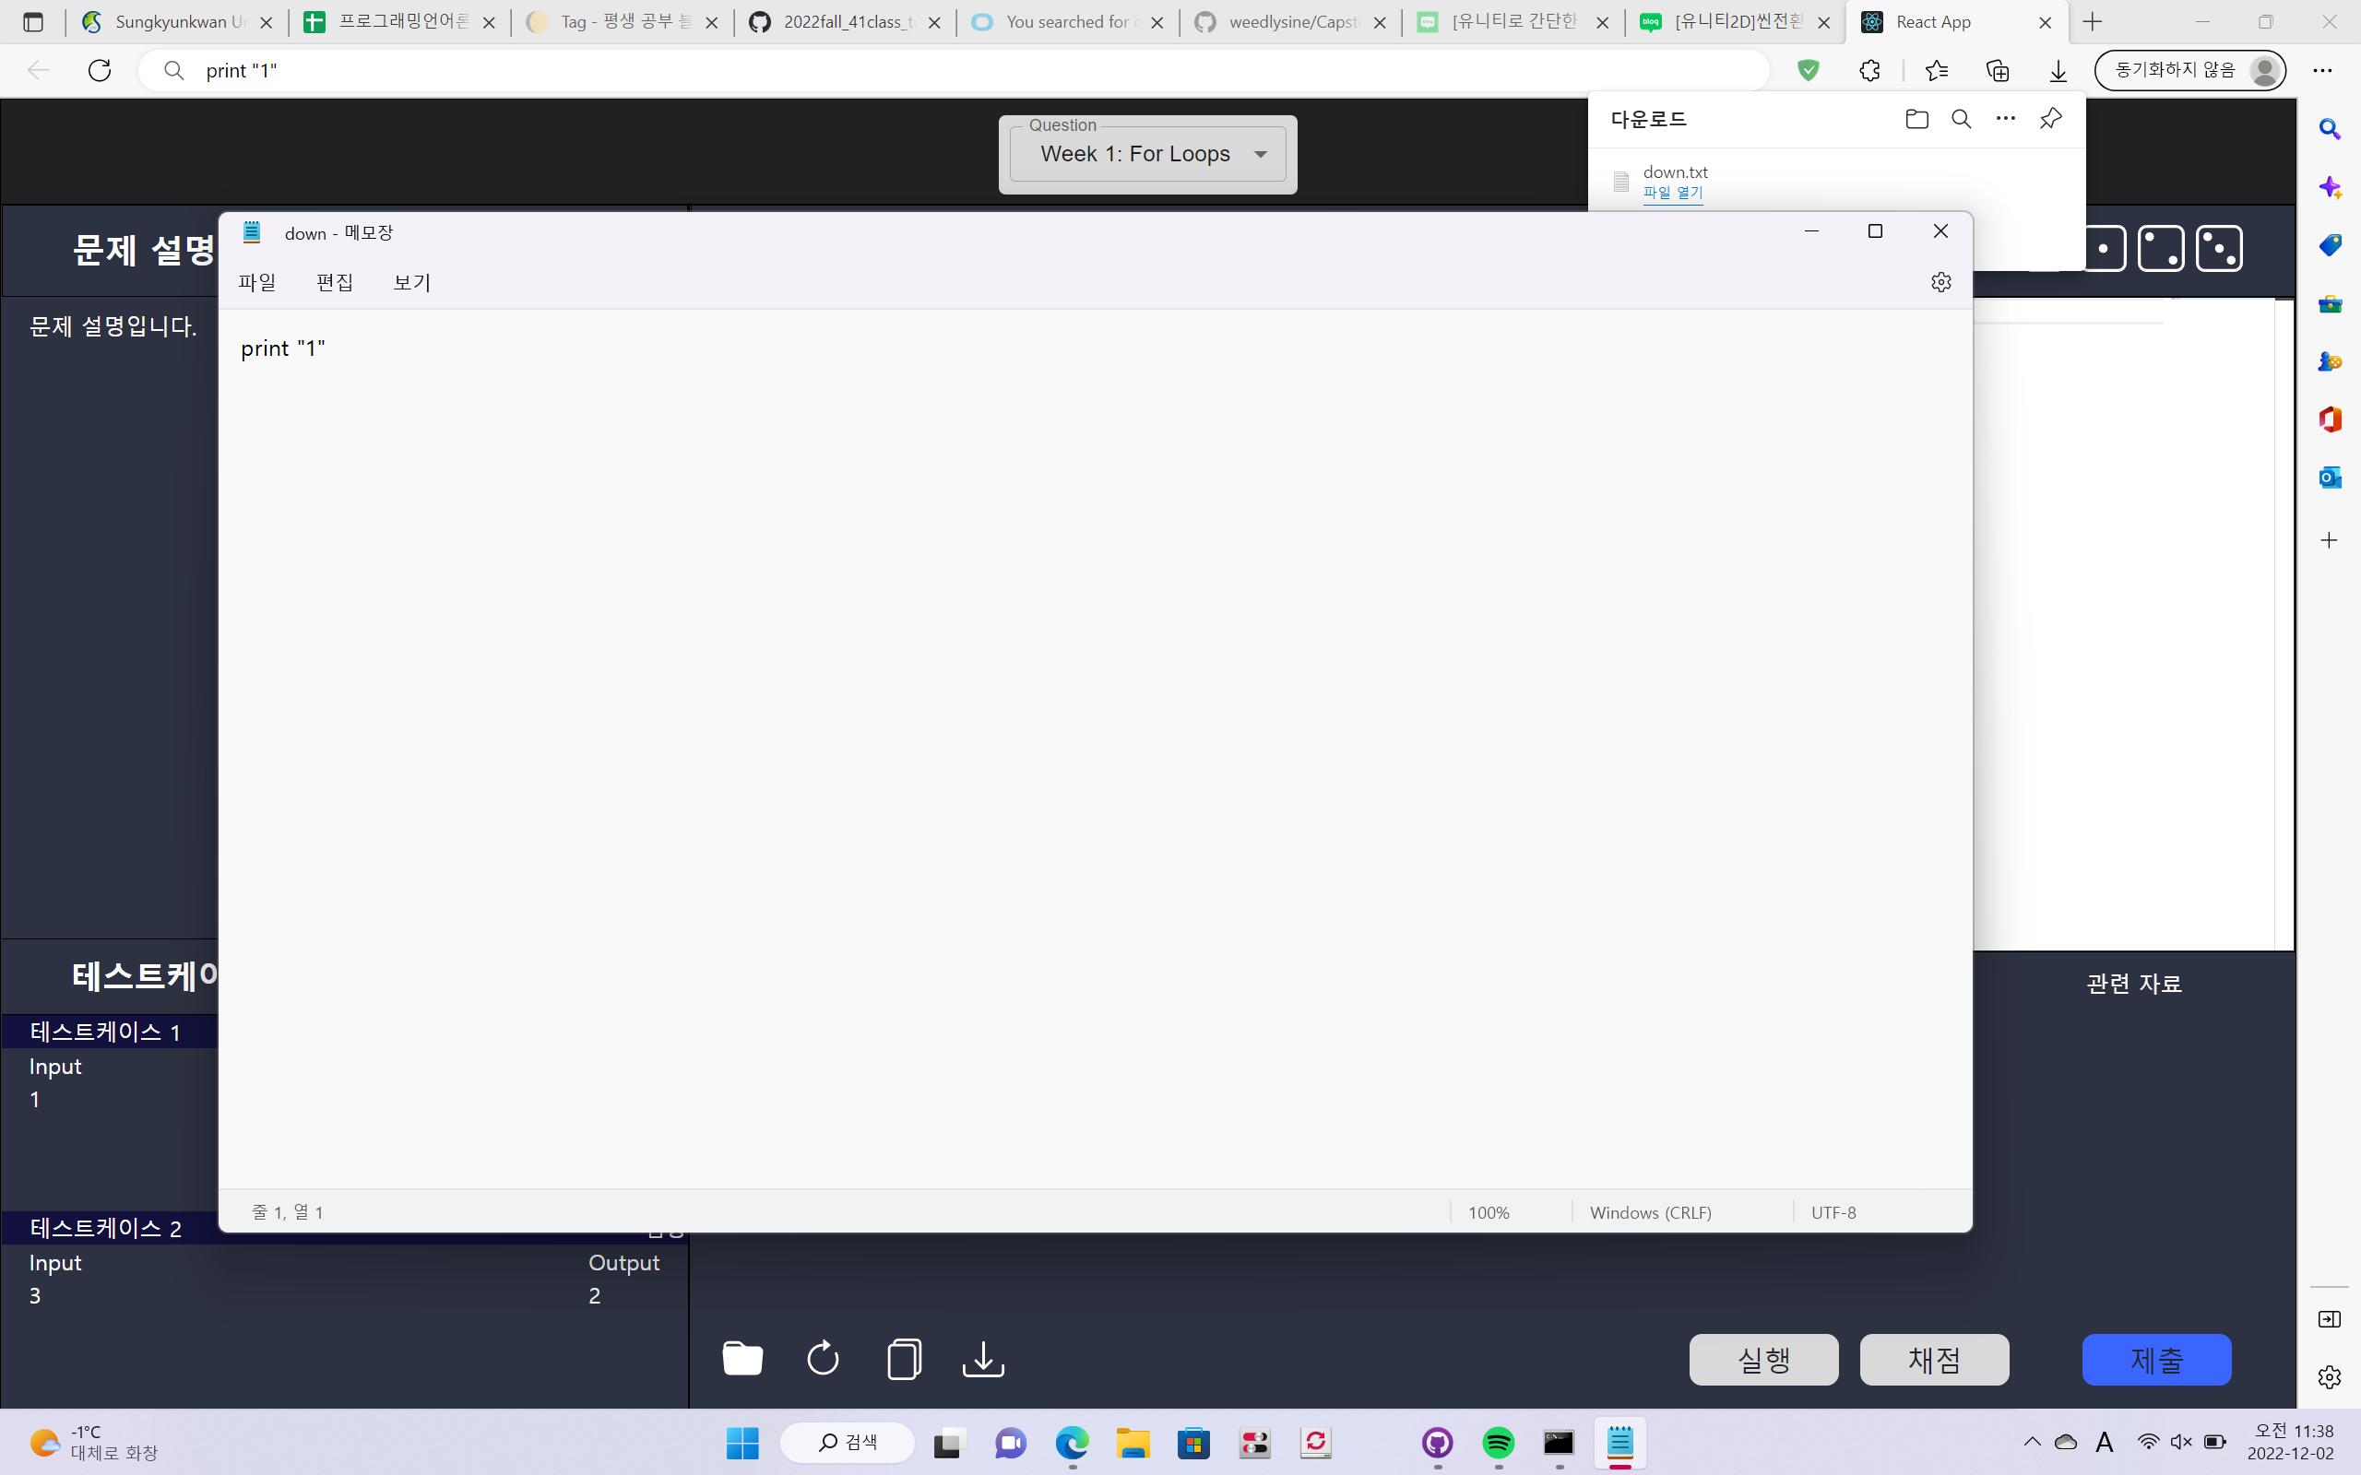
Download Code
You can download your code into text file

Slide 15
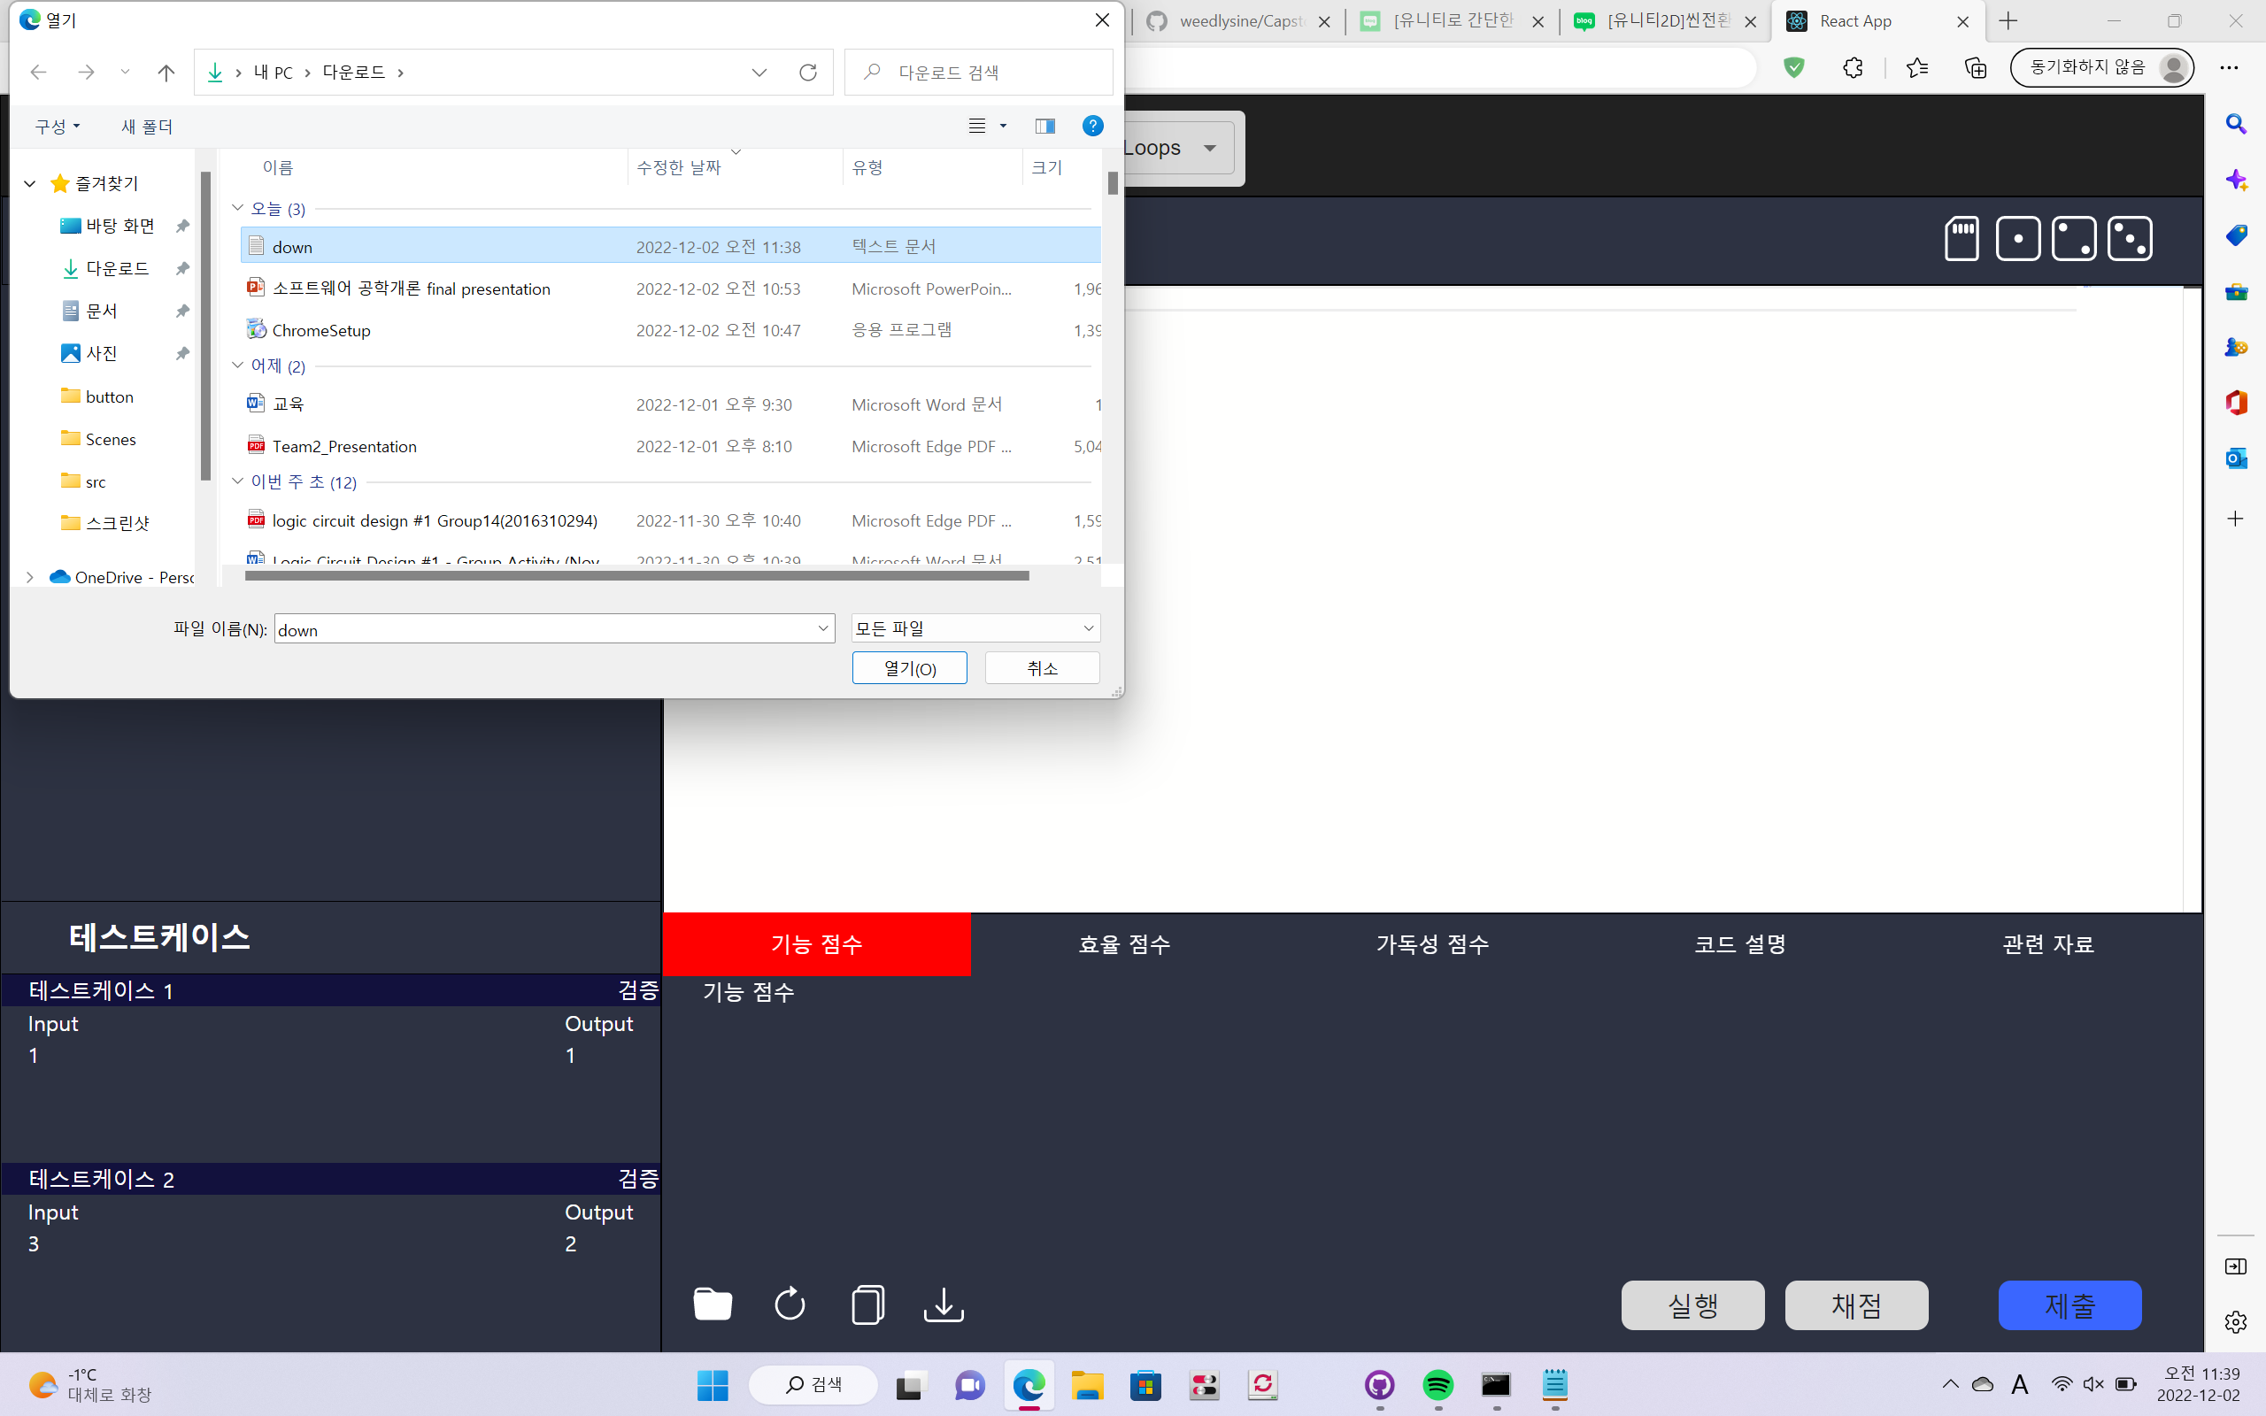
Load Code
You can load your code in your local file

Slide 16
Back-End

Slide 17
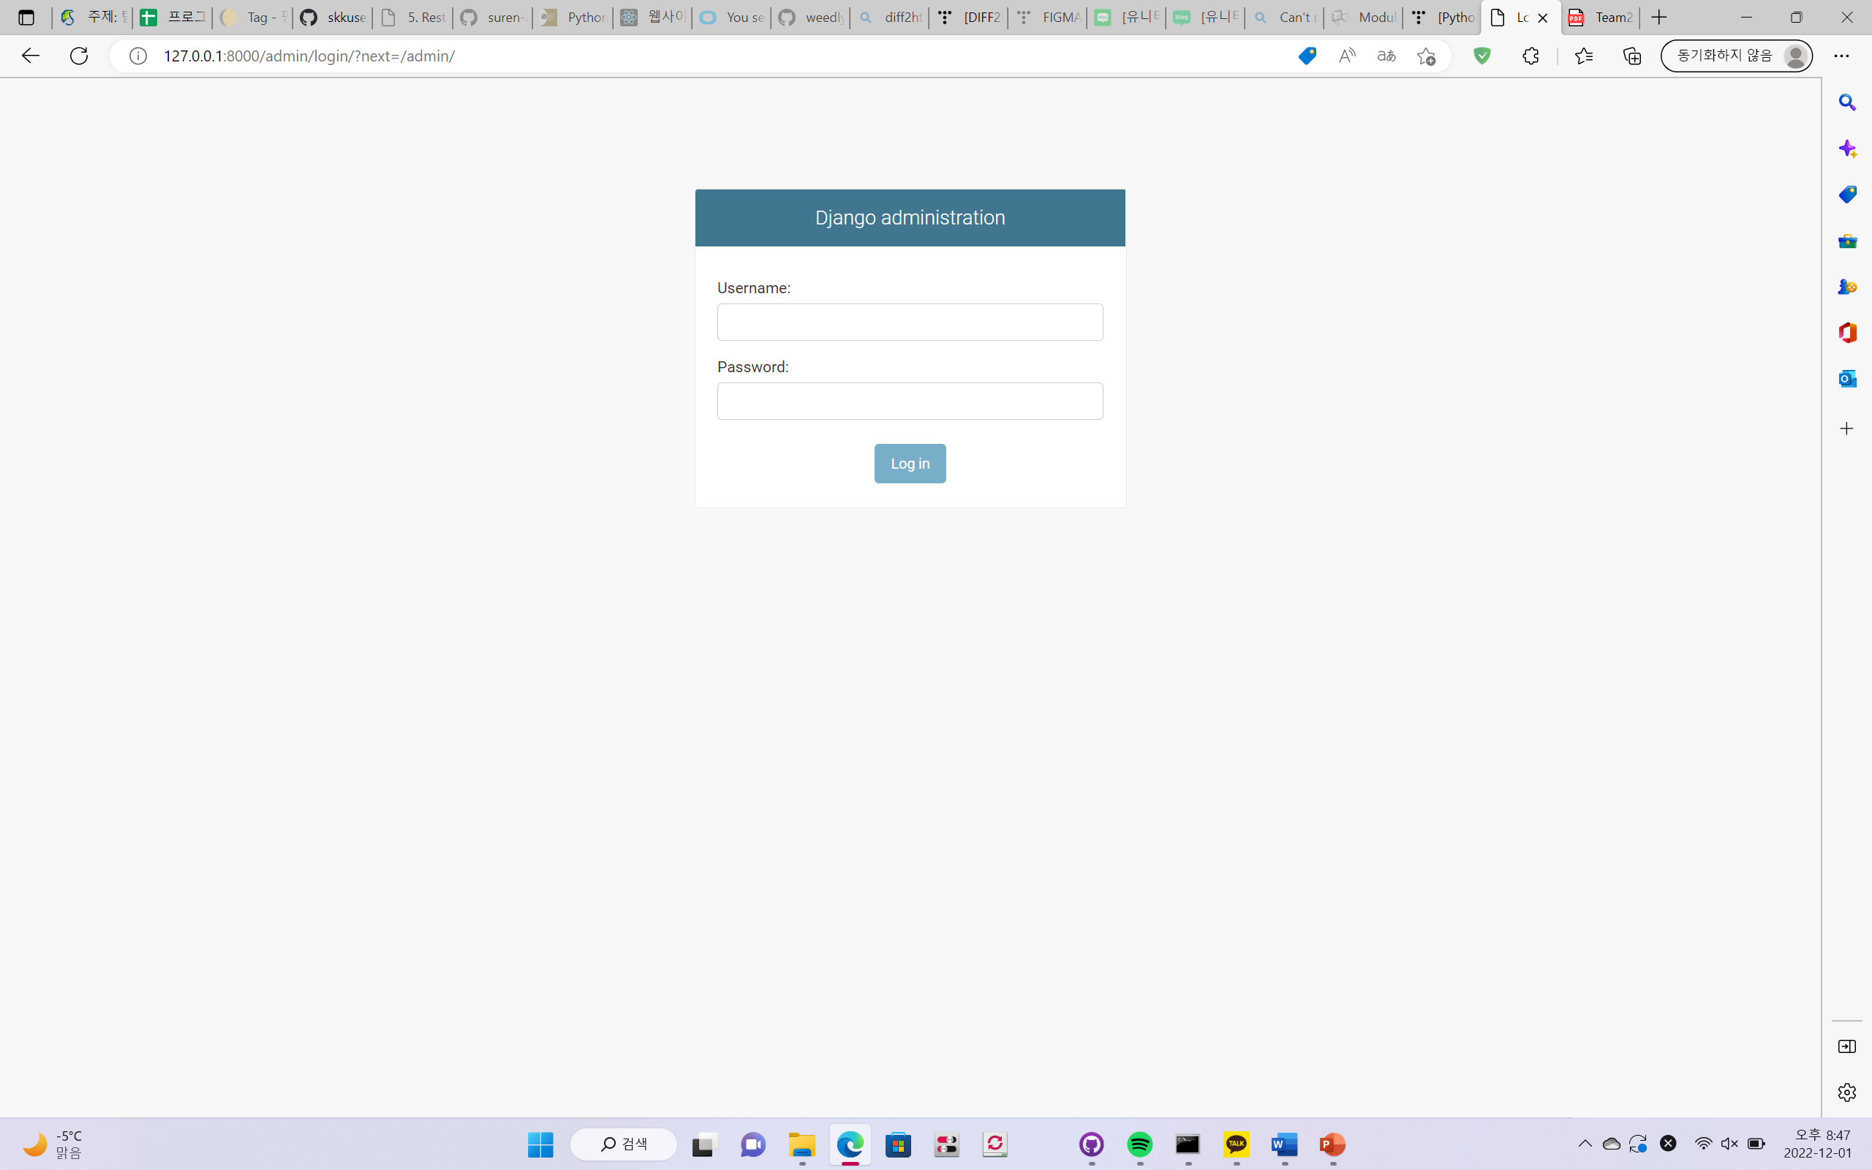
Admin log-in page

Slide 18
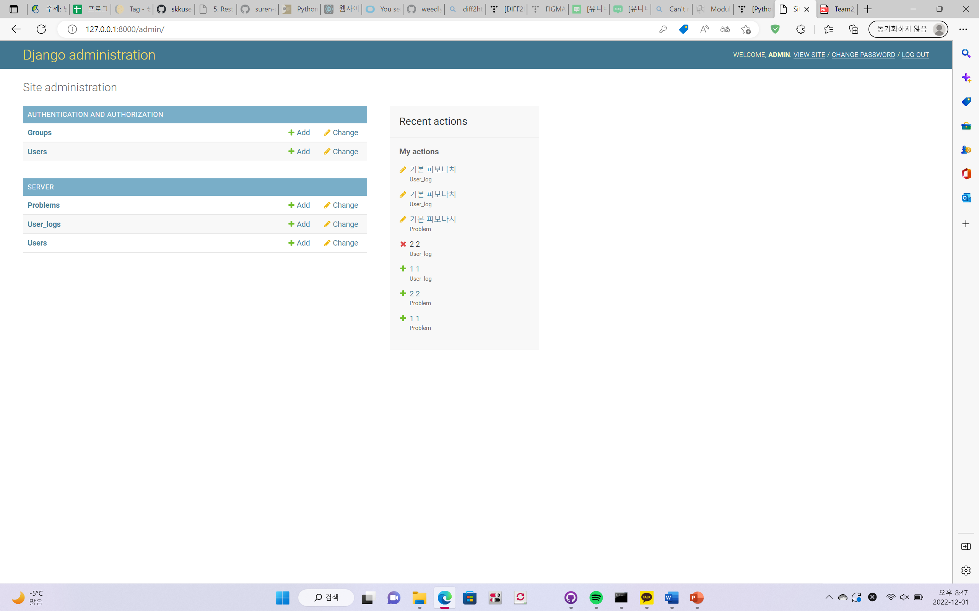
Admin page
You can add problems
You can add users
You can add group
You can see recent actions

Slide 19
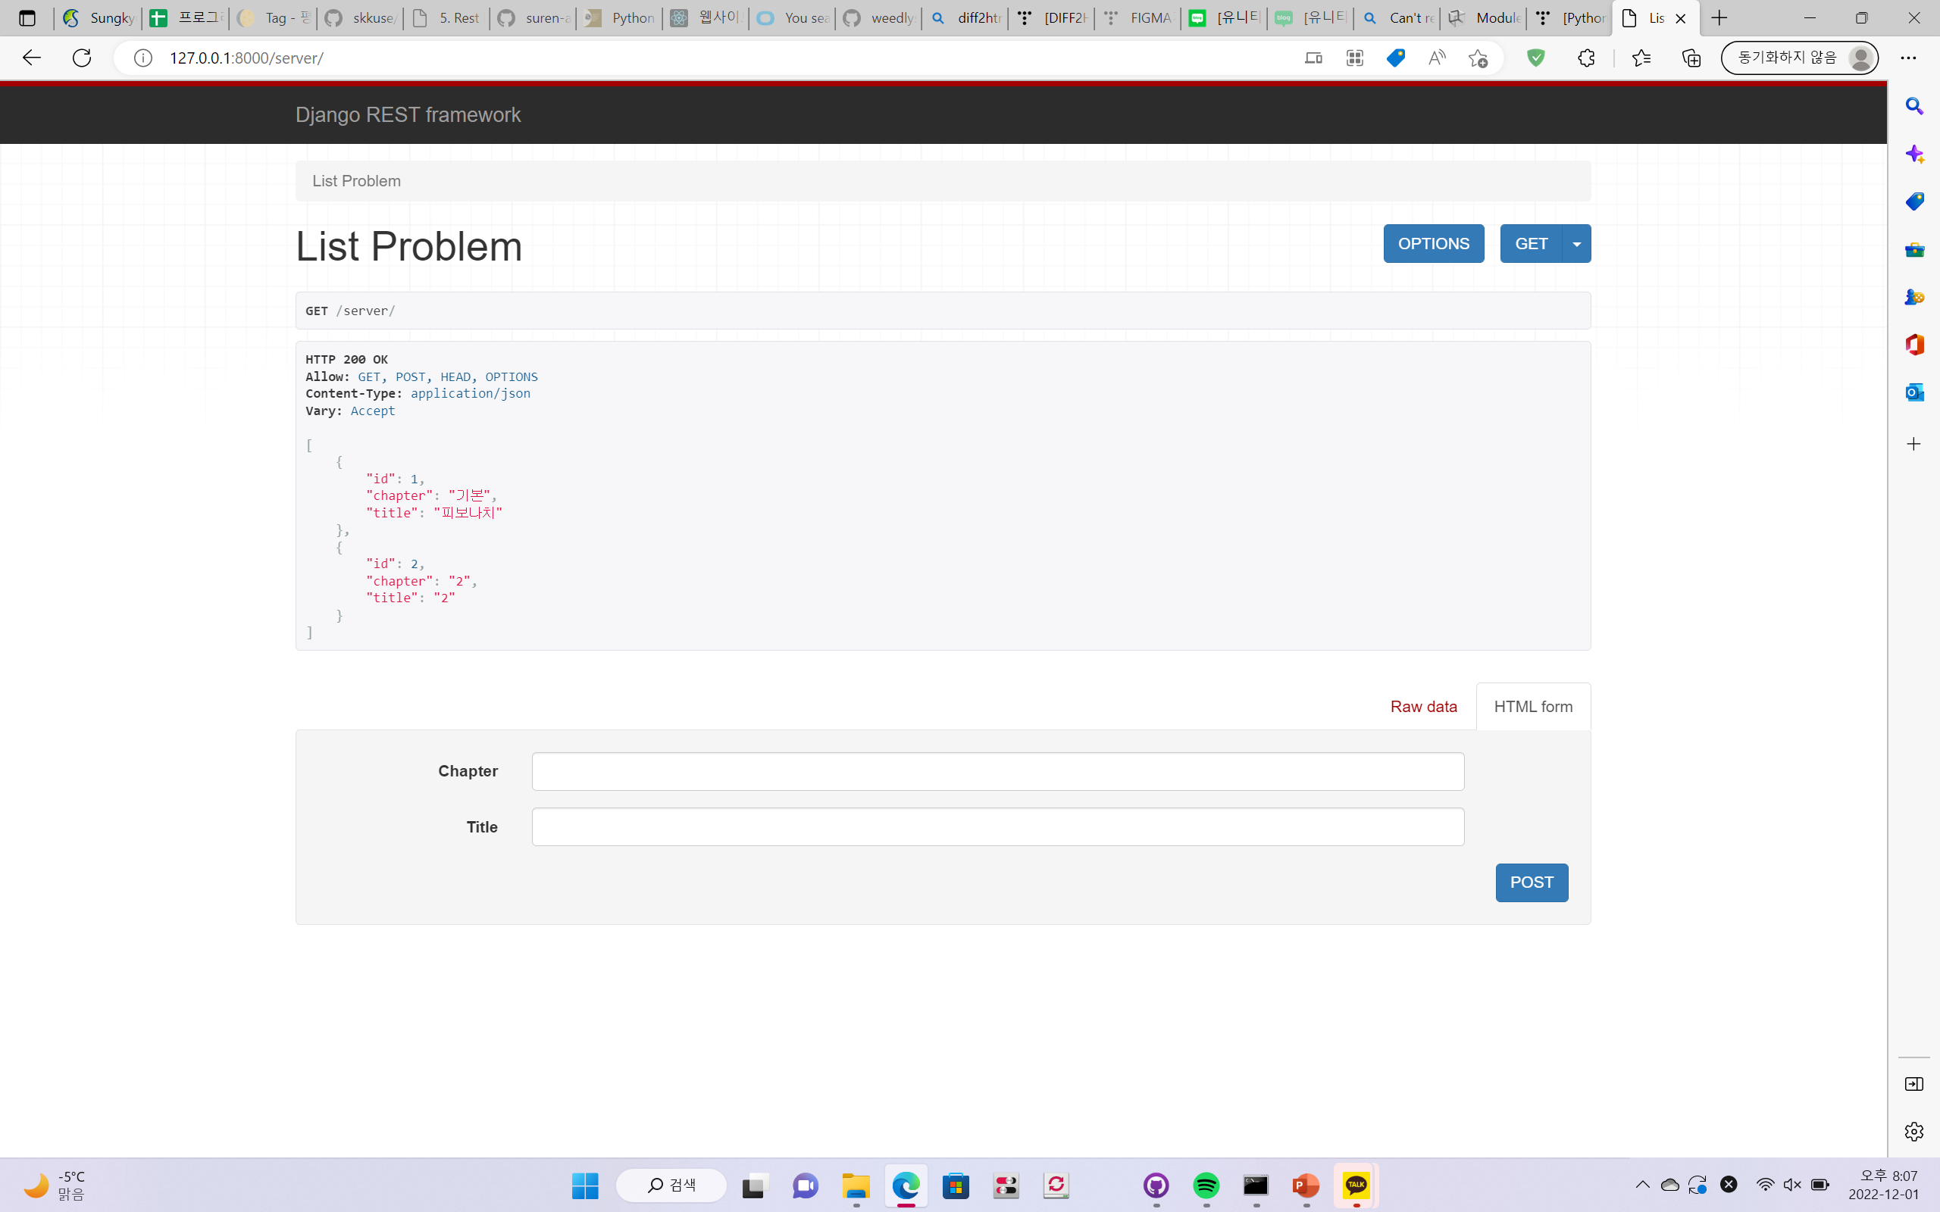
Server
Server saves problem data
You can add data in server
You can visit problem’s detail through server by using problem ID

Slide 20
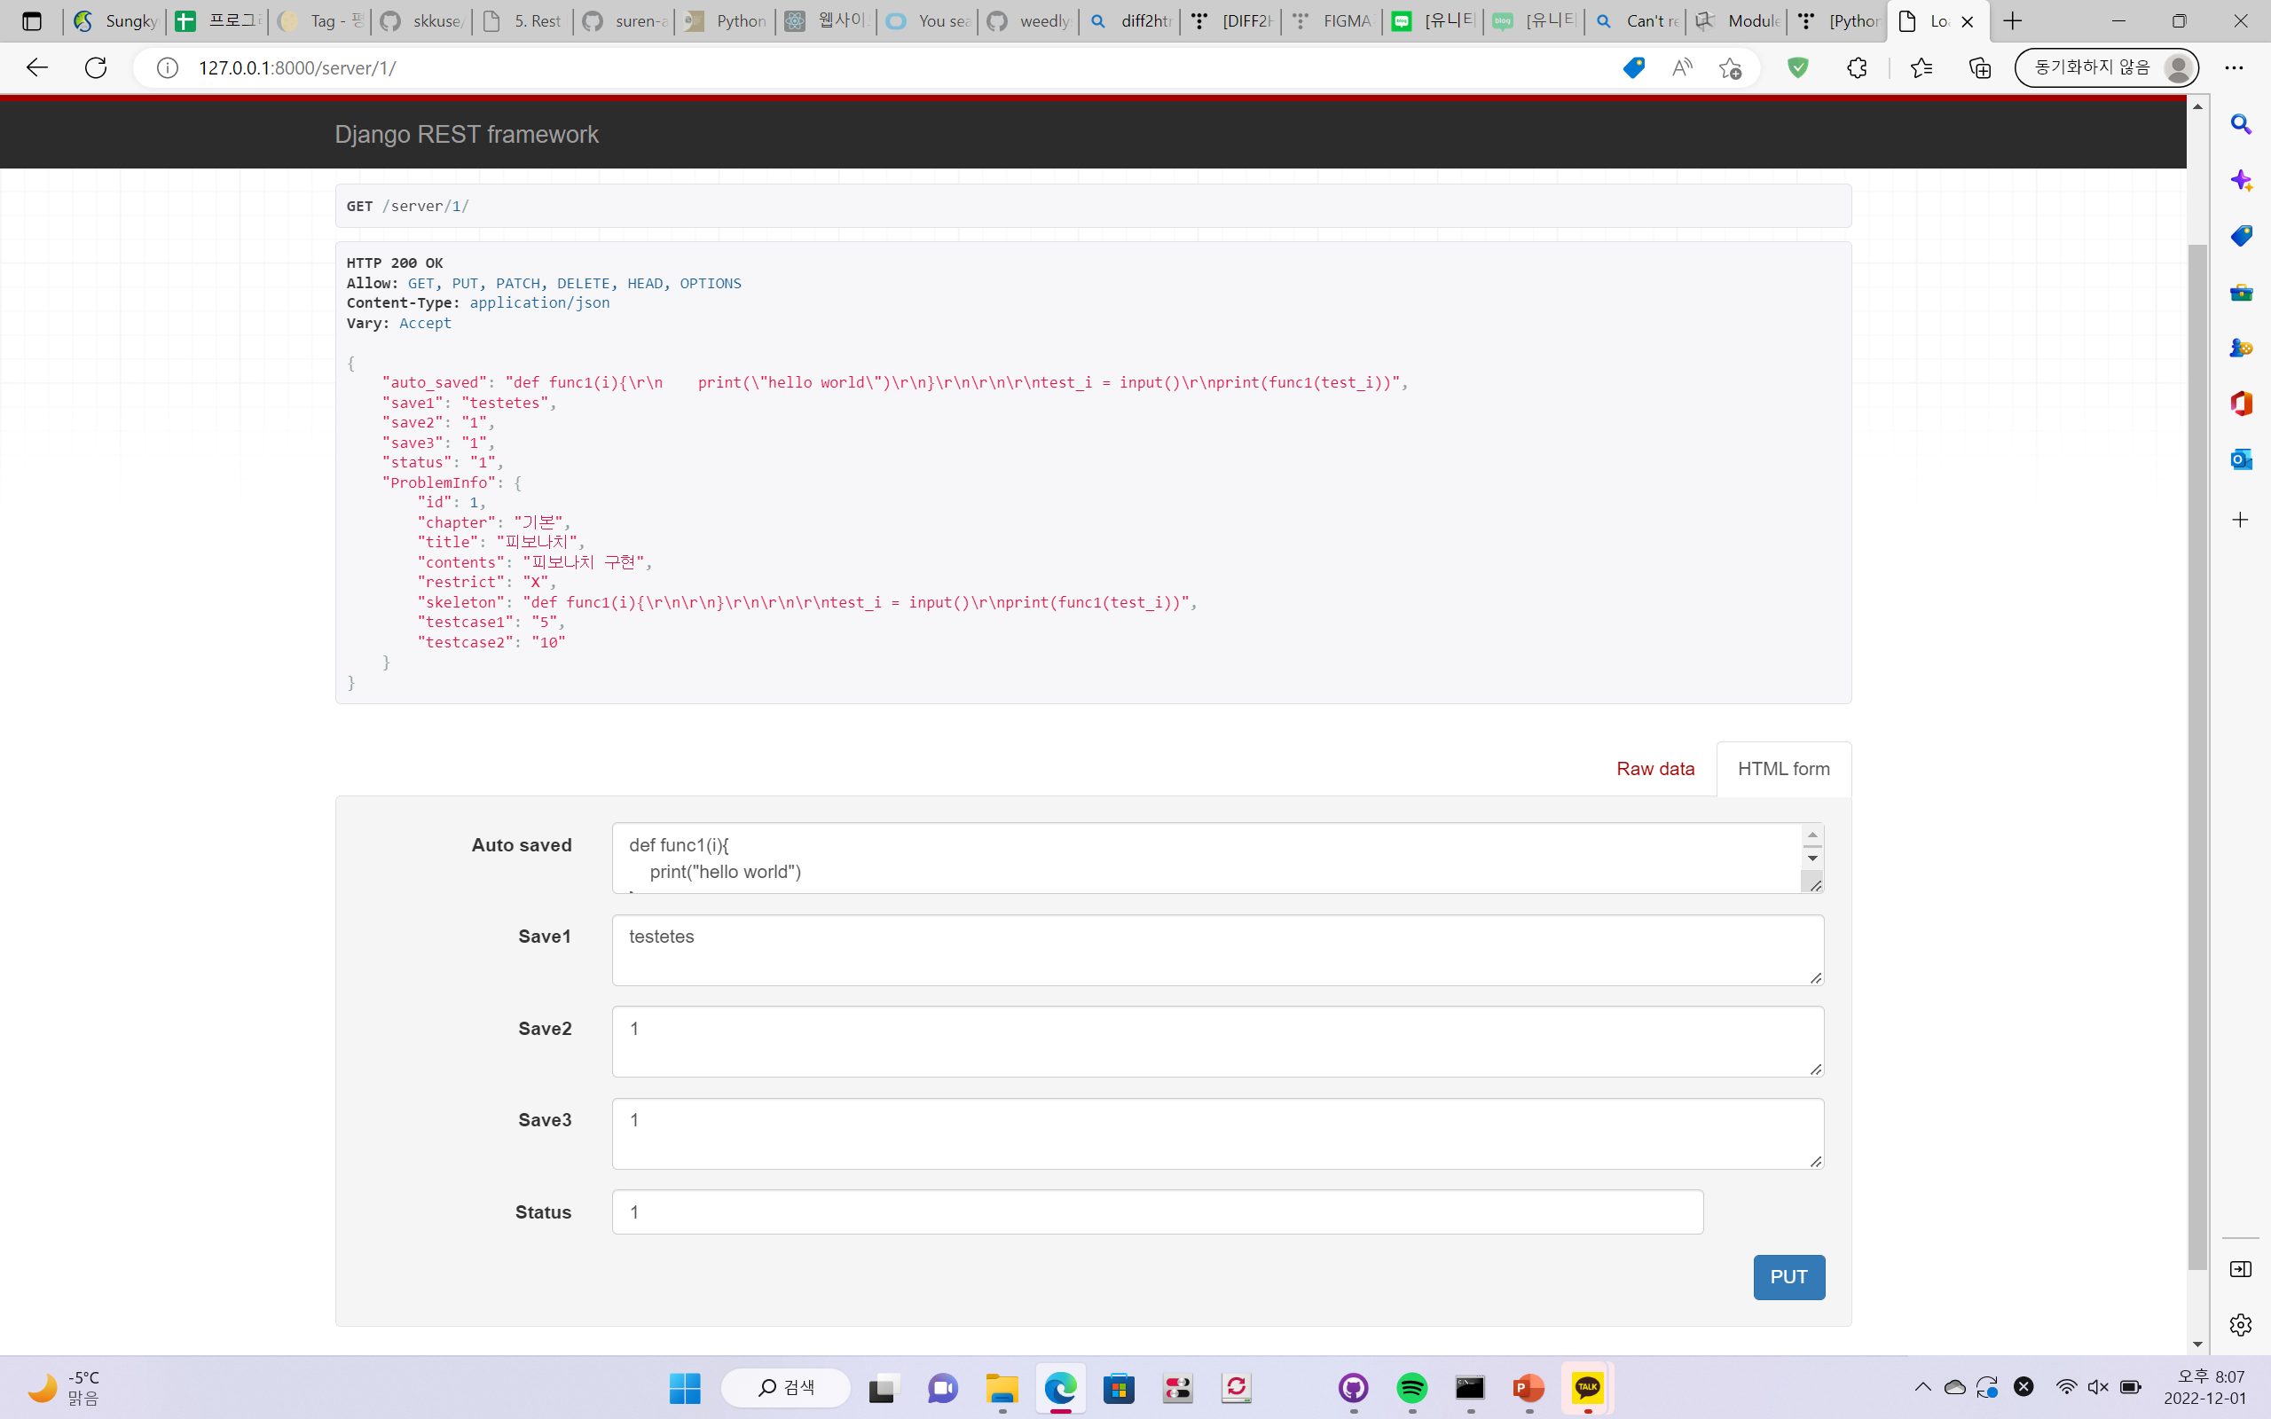
Problem
Detail data of problem
Show what will be posted in web
Provide skeleton code
Provide test case
Save data when user saved
Scoring by adding /scoring url

Slide 21
Need Implemet

Slide 22
Show Problem

Slide 23
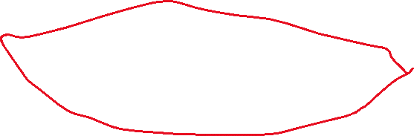
Backend and Frontend Connection

Slide 24

Thank You

